Slide 1

Economics & Business
Lesson 14 – Influences on Work
Outsourcing and Offshoring

Slide 2
Influences on work
today:
Technology
health of the economy,
employer and employee expectations,
consumer demands, and
globalisation.
Changing opportunities
Government regulations and unions

Slide 3

Globalisation is the process that enables markets and companies to operate internationally and world views, products and ideas to be freely exchanged

Slide 4


outsourcing: contracting a person or people outside an organisation to perform certain work tasks
Offshoring
offshoring: moving certain work processes to be performed overseas rather than being carried out ‘in-house’ by an organisation

Slide 5
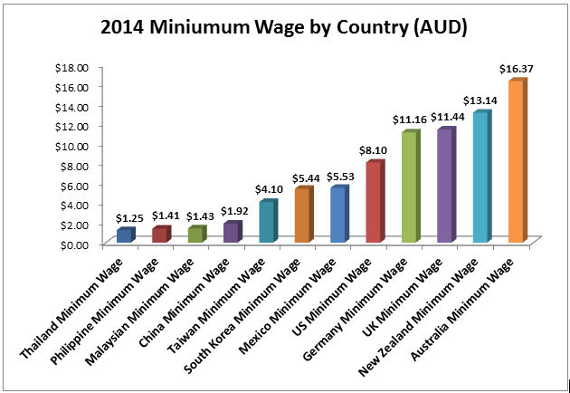
Why offshore?

Slide 6
Impact on consumers | Impact on employers | Impact on employees
goods, some of which are imported into the country, e.g. tinned tomatoes, electrical goods, clothing, wine etc. | Ability to reduce the costs of manufacturing or providing a service by employing cheaper overseas-based labour | Loss of jobs as some roles are moved to overseas providers
Access to goods at lower prices | Access to new markets overseas | Potential for individuals to travel, work and/or study overseas; taking skills, knowledge and capabilities with them
Ability to browse and buy online and have purchases delivered to the door, eliminating the need to travel to stores | Increased ability to access new technologies from overseas | Potential to work for international companies that bring their business to Australia
 | Ability to generate greater income through selling more products to a global market, allowing the potential to further build and develop the business through investment in improvements in technology, productivity and quality | New jobs created as a result of business growth through exporting products such as wine, cars, gas, minerals, to other countries
 | Pressure to become more competitive and produce goods and services more cheaply than overseas competitors

